Slide 1

Software Engineering : Analysis
Lecture 7

Slide 2
Software Analysis
Analysis Modelling
Project Management
Project planning and Scheduling
Project Estimation
Quality Management

Slide 3
Analysis Modeling
Objectives of analysis model
- Domain Analysis
To describe what the customer require
To establish a basis for the creation of a software design
To define a set of requirements that can be validated once the software is built
Analysis Modelling
Project Management
Project planning and Scheduling
Project Estimation
Quality Management

Slide 4
Model
What is a model?
a model is a simplification of reality
Why do we model?
we build models so that we can better understand the system we are developing
we build models of complex systems because we cannot comprehend such a system in its entirety
four aims to achieve
help us to visualize a system
permit us to specify the structure/behavior of a system
give us a template that guides us in constructing systems
document the decisions we have made
Analysis Modelling
Project Management
Project planning and Scheduling
Project Estimation
Quality Management

Slide 5
Elements of the Analysis Model
Scenario-based elements
Flow-oriented elements
Use-case diagrams
Use cases - text
Activity Diagrams
Swim lane diagrams
Data-flow diagrams
Control flow diagrams
Processing narratives
Analysis Model
Class-based elements
Behavioral elements
Class diagrams
Analysis Packages
CRC Models
Collaboration Diagrams
State diagrams
Sequence diagrams
Analysis Modelling
Project Management
Project planning and Scheduling
Project Estimation
Quality Management

Slide 6
Elements of the Analysis Model
Scenario-based elements
Flow-oriented elements
Use-case diagrams
Use cases - text
Activity Diagrams
Swim lane diagrams
Data-flow diagrams
Control flow diagrams
Processing narratives
Analysis Model
Class-based elements
Behavioral elements
Class diagrams
Analysis Packages
CRC Models
Collaboration Diagrams
Sequence diagrams
State Diagram
Analysis Modelling
Project Management
Project planning and Scheduling
Project Estimation
Quality Management

Slide 7
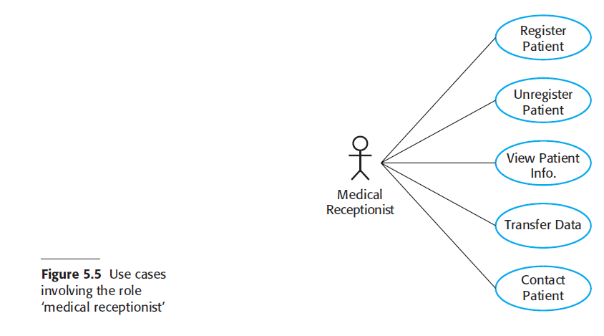
Use Case Diagram
Analysis Modelling
Project Management
Project planning and Scheduling
Project Estimation
Quality Management

Slide 8
Use Case Text
It is effective to use the first person “I” to describe how the actor interacts with the software
Format of the text part of a use case
Use-case title:
Actor:
Description: I …
Analysis Modelling
Project Management
Project planning and Scheduling
Project Estimation
Quality Management

Slide 9
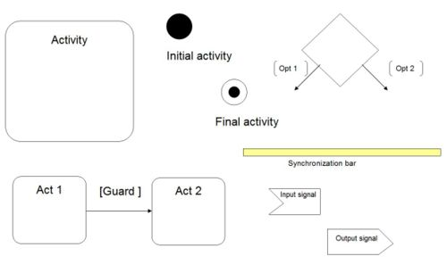
Activity Diagram Tools
Analysis Modelling
Project Management
Project planning and Scheduling
Project Estimation
Quality Management

Slide 10
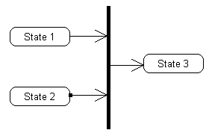
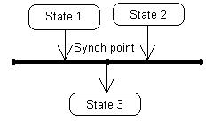
Synchronization Bar
A Synchronization Bar is used to describe an intermediary step in a process in an activity diagram. This intermediary process re-establishes a logical level, usually the result of several inputs.
Analysis Modelling
Project Management
Project planning and Scheduling
Project Estimation
Quality Management

Slide 11
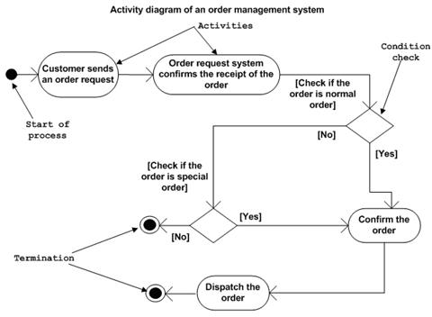
Analysis Modelling
Project Management
Project planning and Scheduling
Project Estimation
Quality Management

Slide 12
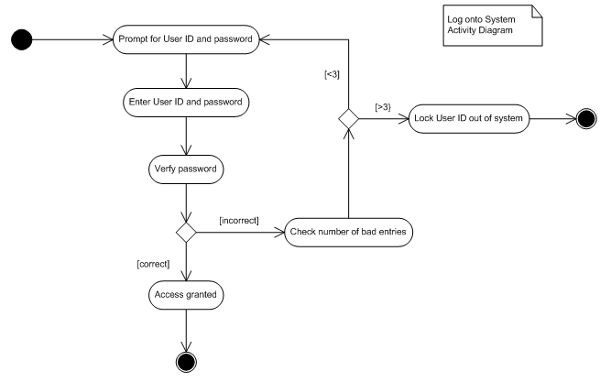
Activity Diagram :Log in System
Analysis Modelling
Project Management
Project planning and Scheduling
Project Estimation
Quality Management

Slide 13
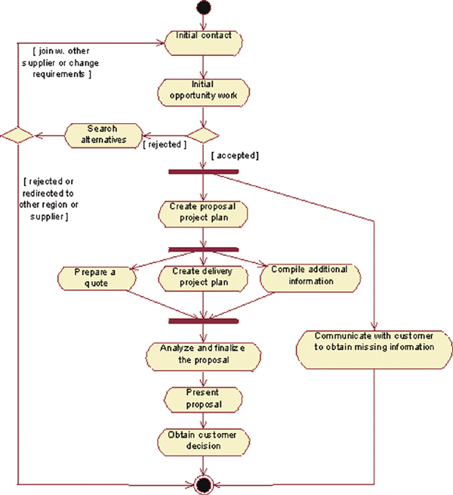

Slide 14
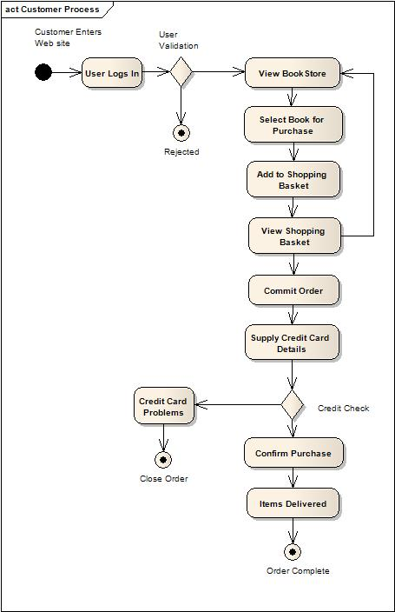
Shopping Cart System
Analysis Modelling
Project Management
Project planning and Scheduling
Project Estimation
Quality Management

Slide 15
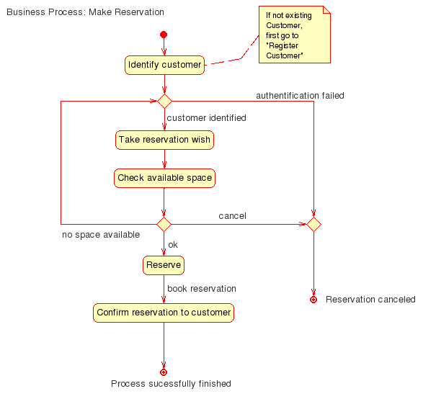
Analysis Modelling
Project Management
Project planning and Scheduling
Project Estimation
Quality Management

Slide 16
Swim lane Diagram
Allows the modeler to represent the flow of activities described by the use-case and at the same time indicate which actor (if there are multiple actors involved in a specific use-case) or analysis class has responsibility for the action described by an activity rectangle
A swim lane diagram, sometimes called a cross-functional diagram
It is a process flowchart that provides richer information on who does what.
It can also be expanded to show times—when tasks are done and how long they take.
Analysis Modelling
Project Management
Project planning and Scheduling
Project Estimation
Quality Management

Slide 17
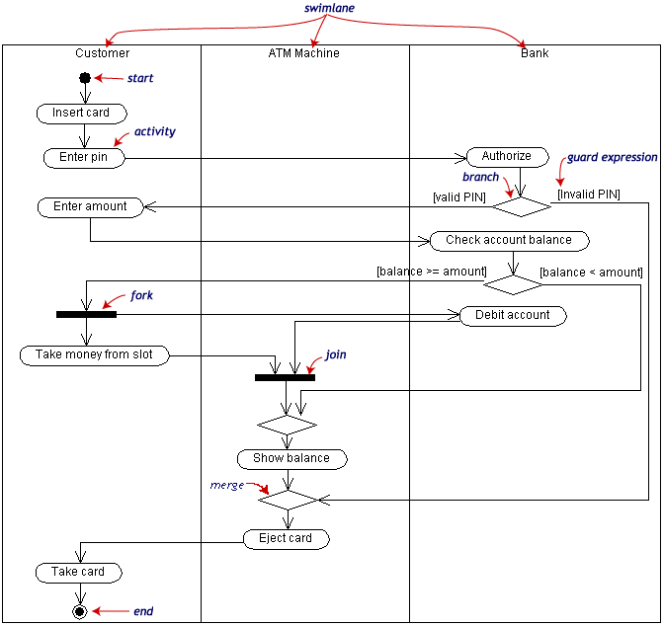
Swim lane Diagram
Analysis Modelling
Project Management
Project planning and Scheduling
Project Estimation
Quality Management

Slide 18
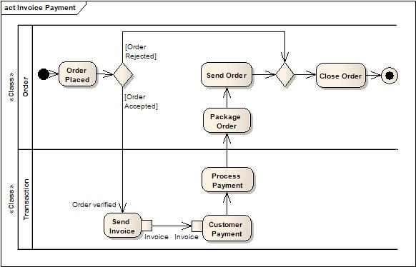
Swim lane Diagram
Analysis Modelling
Project Management
Project planning and Scheduling
Project Estimation
Quality Management

Slide 19
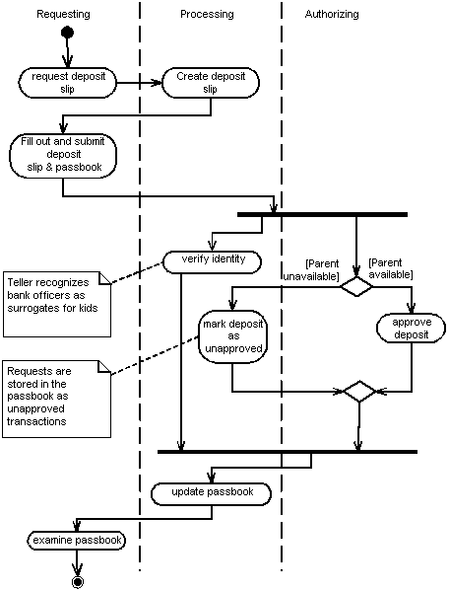

Slide 20
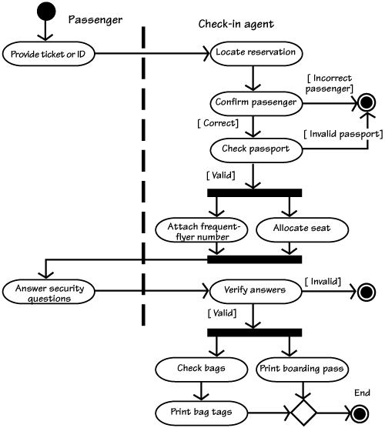
Swim lane Diagram
Reservation System
Analysis Modelling
Project Management
Project planning and Scheduling
Project Estimation
Quality Management

Slide 21
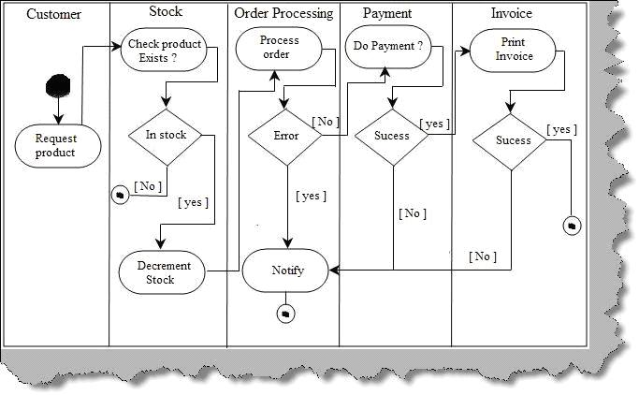
Swim lane Diagram
Analysis Modelling
Project Management
Project planning and Scheduling
Project Estimation
Quality Management

Slide 22
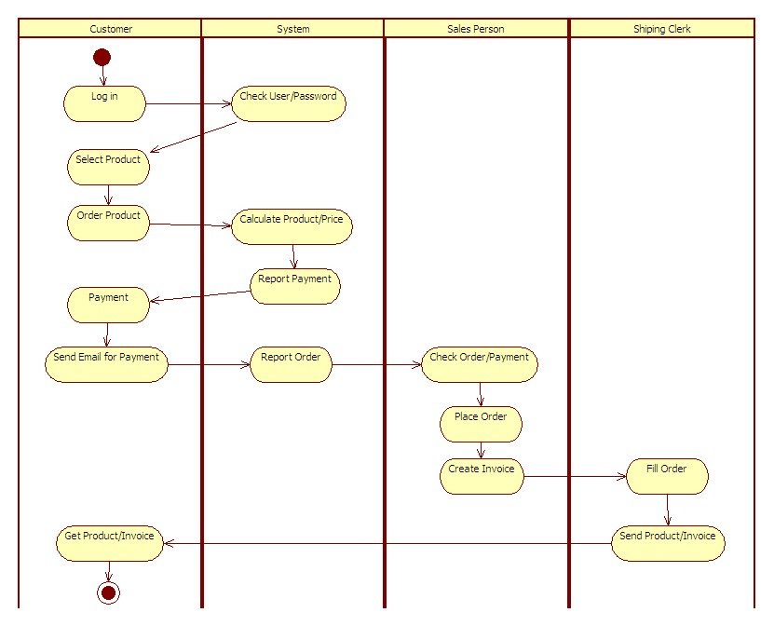
Swim lane Diagram
Analysis Modelling
Project Management
Project planning and Scheduling
Project Estimation
Quality Management

Slide 23
Sequence Diagram
The sequence diagram is used primarily to show the interactions between objects in the sequential order.
One of the primary uses of sequence diagrams is in the transition from requirements expressed as use cases to the next and more formal level of refinement.
Use cases are often refined into one or more sequence diagrams.
In addition to their use in designing new systems, sequence diagrams can be used to document how objects in an existing (call it "legacy") system currently interact.
Analysis Modelling
Project Management
Project planning and Scheduling
Project Estimation
Quality Management

Slide 24
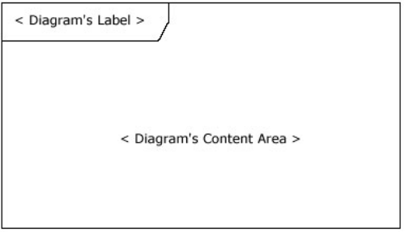

Sequence Diagram
Analysis Modelling
Project Management
Project planning and Scheduling
Project Estimation
Quality Management

Slide 25
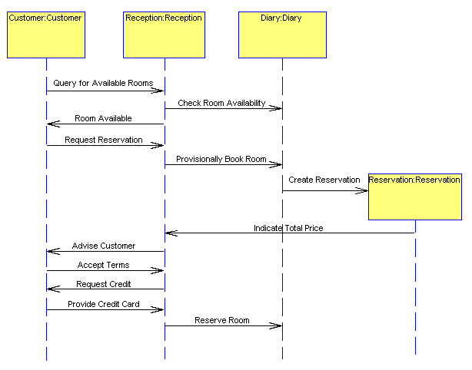
Sequence Diagram
Analysis Modelling
Project Management
Project planning and Scheduling
Project Estimation
Quality Management

Slide 26
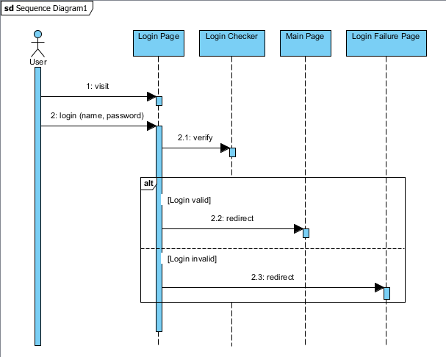
Sequence Diagram
Analysis Modelling
Project Management
Project planning and Scheduling
Project Estimation
Quality Management

Slide 27
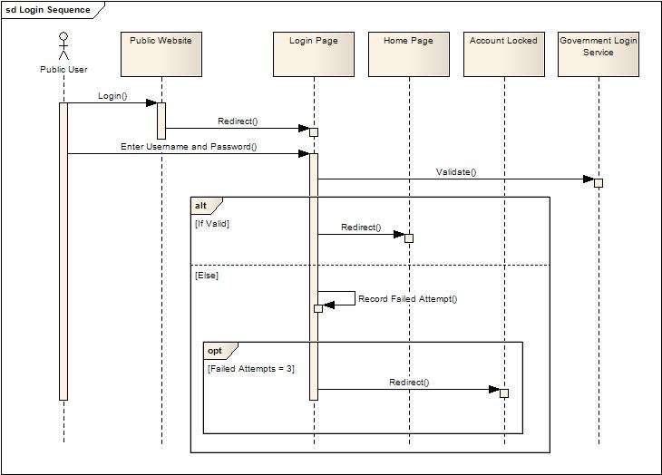
Sequence Diagram
Analysis Modelling
Project Management
Project planning and Scheduling
Project Estimation
Quality Management

Slide 28
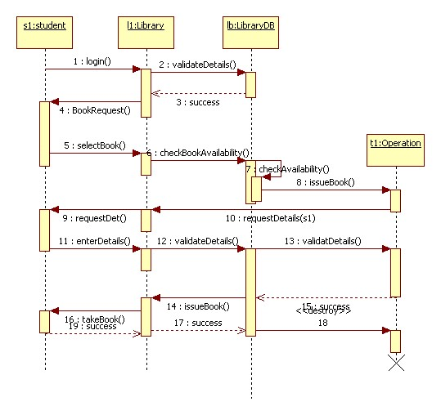
Sequence Diagram
Analysis Modelling
Project Management
Project planning and Scheduling
Project Estimation
Quality Management

Slide 29
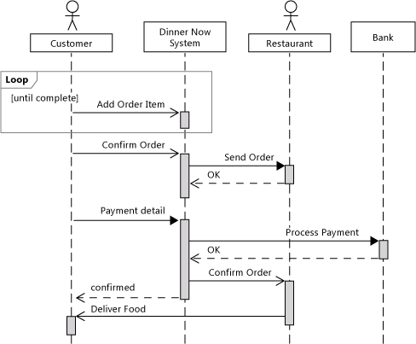
Sequence Diagram
Analysis Modelling
Project Management
Project planning and Scheduling
Project Estimation
Quality Management

Slide 30
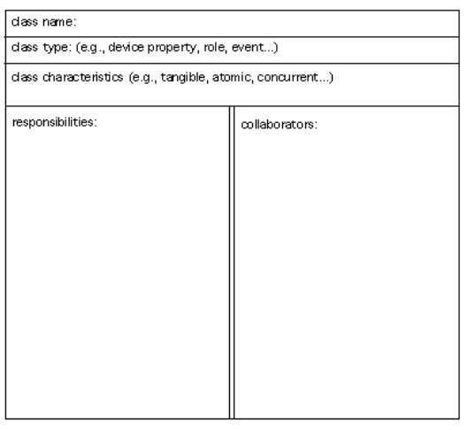
CRC
Class responsibility Collaborator
CRC Index Card
Analysis Modelling
Project Management
Project planning and Scheduling
Project Estimation
Quality Management

Slide 31
Registrar
Student
Class
Class Section
Grade
Analysis Modelling
Project Management
Project planning and Scheduling
Project Estimation
Quality Management

Slide 32
Identifying Analysis Classes From a System
General classifications for a potential class
External entity (e.g., another system, a device, a person)
Thing (e.g., report, screen display)
Occurrence or event (e.g., movement, completion)
Role (e.g., manager, engineer, salesperson)
Organizational unit (e.g., division, group, team)
Place (e.g., manufacturing floor, loading dock)
Structure (e.g., sensor, vehicle, computer)
Analysis Modelling
Project Management
Project planning and Scheduling
Project Estimation
Quality Management

Slide 33
CRC
Class Types
Roles that people who use the system or that the system keep track of can play.
Devices: Sensors, motors, etc., which the system must monitor or control.
Other ``Things'' (physical objects) that the system must keep track (or an inventory) of.
Properties: Important characteristics or properties of part of the problem domain that the system must remember.
Occurrences or events, provided that the system must maintain a record of them.
Structures, Assemblies, or Organizational Units.
Analysis Modelling
Project Management
Project planning and Scheduling
Project Estimation
Quality Management

Slide 34
CRC
Class Characteristics
Tangibility: Does the class represent a ``tangible'' (physical) object, or is it more ``abstract''?
Inclusiveness: Is the class ``atomic,'' or is ``aggregate'' - that is, an assembly (so, that, it contains objects from other classes, as shown by a whole-part structure)?
Sequentiality : Is the class ``sequential,'' so that its operation is controlled by external changes, or is it ``concurrent,'' so that it behaves independently from other parts of the system - has its own thread of control?
Analysis Modelling
Project Management
Project planning and Scheduling
Project Estimation
Quality Management

Slide 35
CRC
Class Characteristics
Persistence:Is the class ``transient,'' so that its objects are all destroyed when the system quits, or is it ``persistent,'' so that its objects must be stored when the system quits and restored the next time the system starts up?
Integrity: Is the class ``corruptible,'' in the sense that it doesn't protect its internal resources from outside influence, or is it ``guarded,'' in the sense that its resources are protected?
Analysis Modelling
Project Management
Project planning and Scheduling
Project Estimation
Quality Management

Slide 36
CRC
Class Name: Registrar Class Type: Role Class Characteristics: Tangible; sequential; persistent; guarded
Class Name: Student Class Type: Role Class Characteristics: Tangible; sequential; persistent; guarded
Class Name: Course Class Type: Structure, Assembly, or Organizational Unit Class Characteristics: Abstract; sequential; persistent; guarded
Analysis Modelling
Project Management
Project planning and Scheduling
Project Estimation
Quality Management

Slide 37
CRC
Class Name: Course Section Class Type: Structure, Assembly, or Organizational Unit Class Characteristics: Abstract, sequential; persistent; guarded
Class Name: Grade Class Type: Property Class Characteristics: Abstract; sequential; persistent; guarded
Analysis Modelling
Project Management
Project planning and Scheduling
Project Estimation
Quality Management

Slide 38
CRC
Operations on Registrars' Accounts
Operations corresponding to the requests
Create Account
Delete Account
Change Access Level for Account
Change Password
List Accounts
Operations on Courses
The operations corresponding to the requests
Create New Course
Update Course Information
Display Course Information
List All Courses
Delete Course
Analysis Modelling
Project Management
Project planning and Scheduling
Project Estimation
Quality Management

Slide 39
CRC
Operations on Course Sections
Create New Course Section
Update Course Section Information
List Sections for Course
Display Course Section Information
Delete Course Section
Operations on Students
The operations
Enter New Student
Update Student Information
List All Students
Display Student Information
Delete Old Students
Analysis Modelling
Project Management
Project planning and Scheduling
Project Estimation
Quality Management

Slide 40
CRC
Operations on Registrations and Grades
The operations
Register Student
Withdraw Student
Change Grade
Analysis Modelling
Project Management
Project planning and Scheduling
Project Estimation
Quality Management

Slide 41
CRC
Class Name: Course Section Class Type: Structure, Assembly, or Organizational Unit Class Characteristics: Abstract, sequential; persistent; guarded
Class Name: Grade Class Type: Property Class Characteristics: Abstract; sequential; persistent; guarded
Analysis Modelling
Project Management
Project planning and Scheduling
Project Estimation
Quality Management

Slide 42
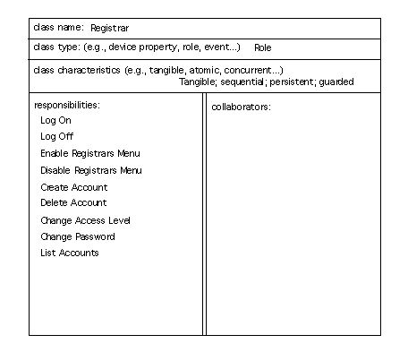

Slide 43
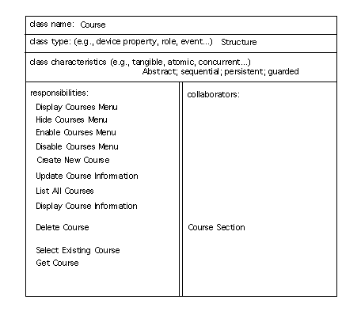

Slide 44
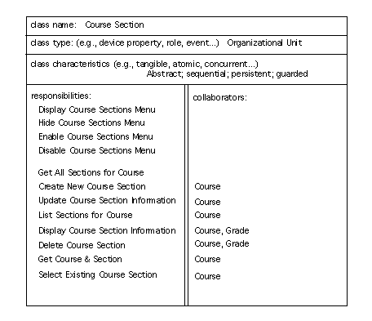

Slide 45
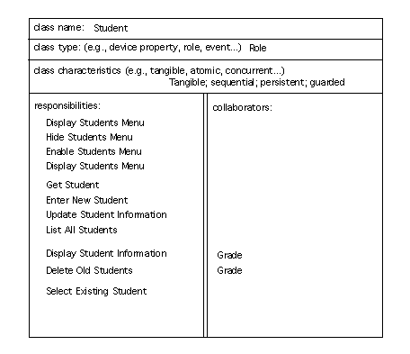

Slide 46
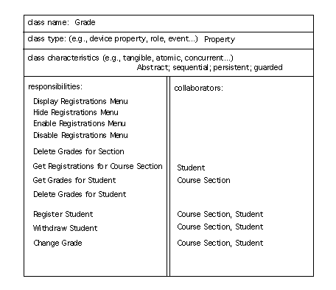

Slide 47
Class Diagram
The class diagram is a static diagram. It represents the static view of an application.
Class diagram is not only used for visualizing, describing and documenting different aspects of a system but also for constructing executable code of the software application.
The class diagram describes the attributes and operations of a class
The UML diagrams like activity diagram, sequence diagram can only give the sequence flow of the application but class diagram is a bit different. So it is the most popular UML diagram in the coder community.
So the purpose of the class diagram can be summarized as:
Analysis and design of the static view of an application.
Describe responsibilities of a system.
Base for component and deployment diagrams.
Forward and reverse engineering.
Analysis Modelling
Project Management
Project planning and Scheduling
Project Estimation
Quality Management

Slide 48
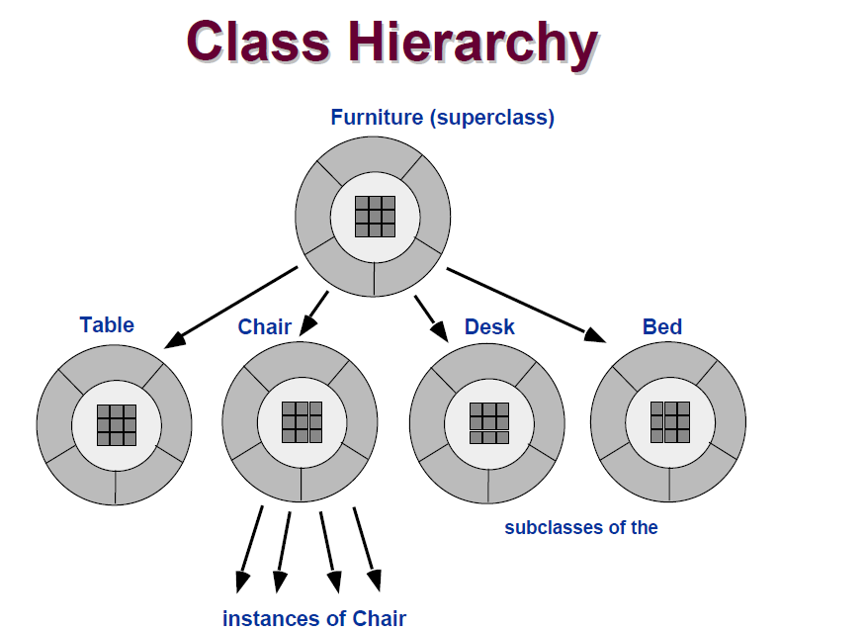
Identifying Analysis Classes
Analysis Modelling
Project Management
Project planning and Scheduling
Project Estimation
Quality Management

Slide 49
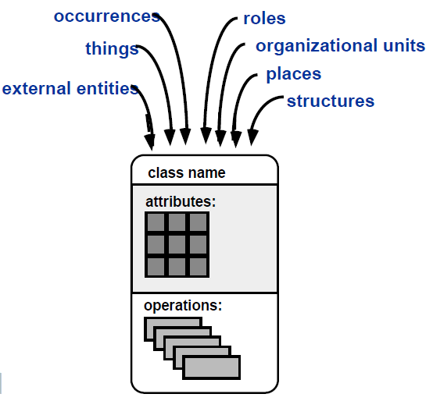
Example of Class Box
Analysis Modelling
Project Management
Project planning and Scheduling
Project Estimation
Quality Management

Slide 50
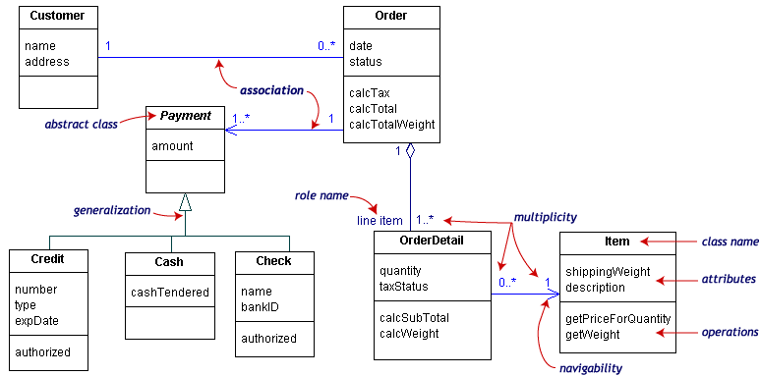
Class Diagram Drawing
Analysis Modelling
Project Management
Project planning and Scheduling
Project Estimation
Quality Management

Slide 51
Class Diagram Drawing
Our class diagram has three kinds of relationships.
association -- a relationship between instances of the two classes. There is an association between two classes if an instance of one class must know about the other in order to perform its work. In a diagram, an association is a link connecting two classes.
aggregation -- an association in which one class belongs to a collection. An aggregation has a diamond end pointing to the part containing the whole. In our diagram, Order has a collection of OrderDetails.
generalization -- an inheritance link indicating one class is a superclass of the other. A generalization has a triangle pointing to the superclass. Payment is a superclass of Cash, Check, and Credit.
An end may have a role name to clarify the nature of the association. For example, an OrderDetail is a line item of each Order.
A navigability arrow on an association shows which direction the association can be traversed or queried. An OrderDetail can be queried about its Item, but not the other way around.
Analysis Modelling
Project Management
Project planning and Scheduling
Project Estimation
Quality Management

Slide 52
Class Diagram Drawing
The multiplicity of an association end is the number of possible instances of the class associated with a single instance of the other end. Multiplicities are single numbers or ranges of numbers. In our example, there can be only one Customer for each Order, but a Customer can have any number of Orders.
This table gives the most common multiplicities.
Multiplicities | Meaning
0..1 | Zero or one instance. The notation
0..* or * | No limit on the number of instances (including none).
1 | Exactly one instance
1..* | At least one instance
Analysis Modelling
Project Management
Project planning and Scheduling
Project Estimation
Quality Management

Slide 53
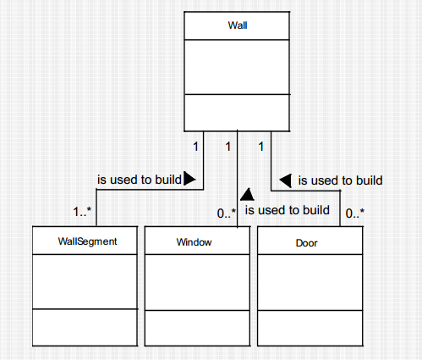
Multiplicity
Analysis Modelling
Project Management
Project planning and Scheduling
Project Estimation
Quality Management

Slide 54
Example
Now the following diagram is an example of an Order System of an application. So it describes a particular aspect of the entire application.
First of all Order and Customer are identified as the two elements of the system and they have a one to many relationship because a customer can have multiple orders.
We would keep Order class is an abstract class and it has two concrete classes (inheritance relationship) SpecialOrder and NormalOrder.
The two inherited classes have all the properties as the Order class. In addition they have additional functions like dispatch () and receive ().
Analysis Modelling
Project Management
Project planning and Scheduling
Project Estimation
Quality Management

Slide 55
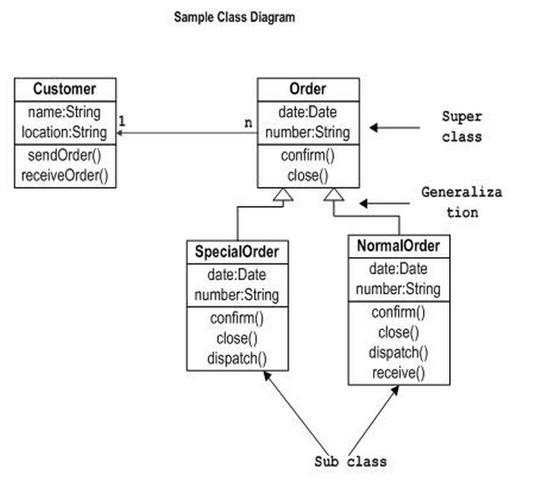
Example
Analysis Modelling
Project Management
Project planning and Scheduling
Project Estimation
Quality Management

Slide 56
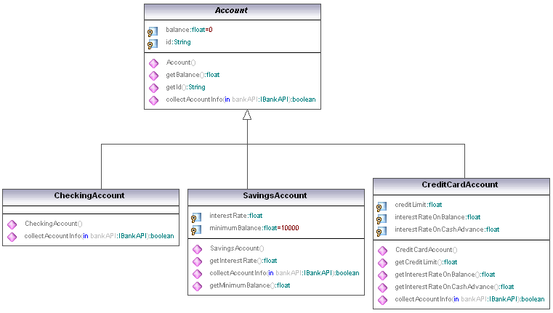
Example
Analysis Modelling
Project Management
Project planning and Scheduling
Project Estimation
Quality Management

Slide 57
Example
Library class hierarchy
Analysis Modelling
Project Management
Project planning and Scheduling
Project Estimation
Quality Management

Slide 58
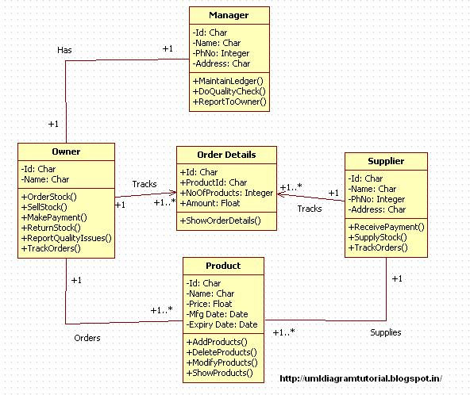
Example
Analysis Modelling
Project Management
Project planning and Scheduling
Project Estimation
Quality Management

Slide 59
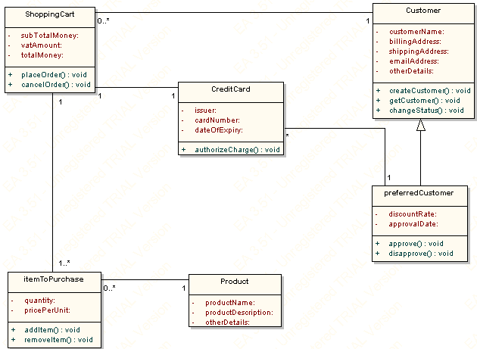
Example
Analysis Modelling
Project Management
Project planning and Scheduling
Project Estimation
Quality Management

